Slide 1
Nuclear Magnetic Resonance
Kitty Harris and Josh Elsarboukh

Slide 2
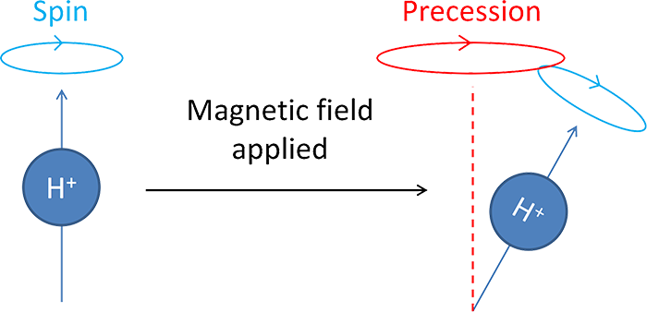
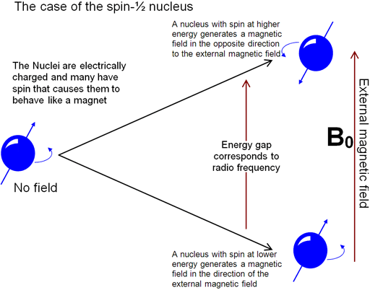


Magnetic Resonance
A physical phenomenon occurring in magnetic moments exposed to external magnetic fields
The energy of each magnetic moment is quantized into energy levels that depend on its angular momentum (quantum # $l)$
In the case of Nuclear Magnetic Resonance, the magnetic moments considered are nuclear protons
Source: radiologycafe.com
The presence of an external magnetic field results in a precession of the magnetic moments about an axis along the field, as described in the image above.
The rate of this precession is known as the Larmor Frequency: $ω_{0}=γB_{0}$ where $γ$ is the gyromagnetic ratio, and $B_{0}$ is the strength of the static magnetic field.
This frequency corresponds to the energy required to affect the spin states, such as the energy from a second, weaker oscillating electromagnetic field.
Thus, a signal with the Larmor frequency is considered “at resonance” with the nuclear sample considered.
Source: NMR Lab at HUJI

Slide 3

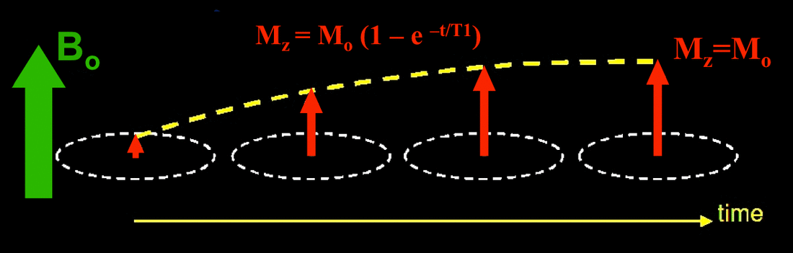
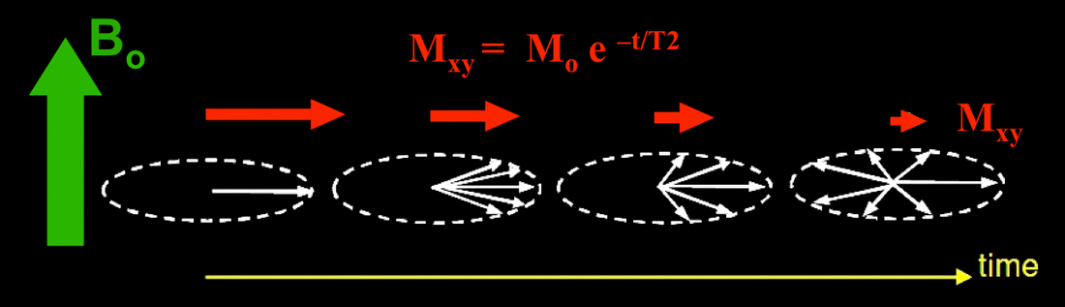
Spin-Lattice and Spin-Spin Relaxation Mechanisms
Spin-Lattice (T1, Longitudinal) Relaxation
Loss of spin energy to other molecules in the surrounding environment.
Restores Boltzmann equilibrium
Lattice motion causes changes in B.
X- and Y- components nullify
In other substances:
Unpaired Electrons (Paramagnetic)
Electric Field Gradients (Spin > ½)
Spin-Spin (T2, Transverse) Relaxation
Interactions between aligned spins
Can also result from field inhomogeneities
T1 Relaxation: Spins reset to the vertical direction.
T2 Relaxation: Spins spread out, reducing the total.
Can occur with or without Spin-Lattice relaxation, but is always present if we see T1 relaxation
Situations which cause spins to re-align upward allow them to interact with one another
Spin relaxation toward the z-direction affects xy-contributions of individual spins

Slide 4
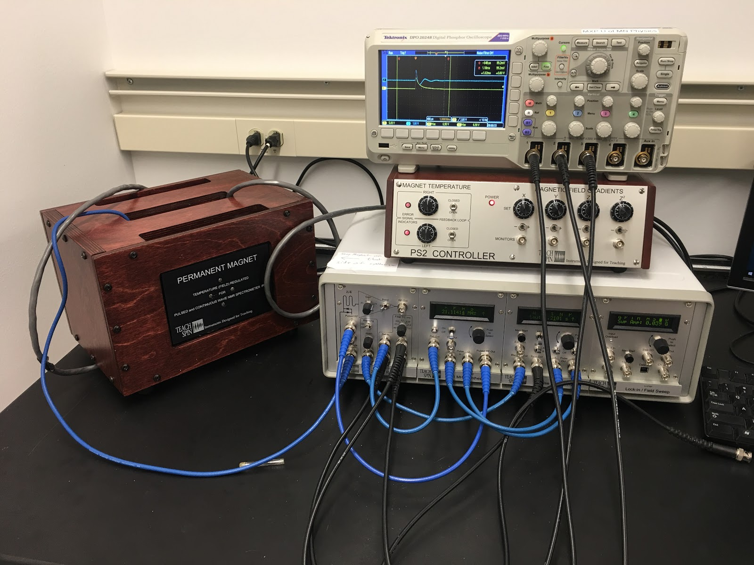
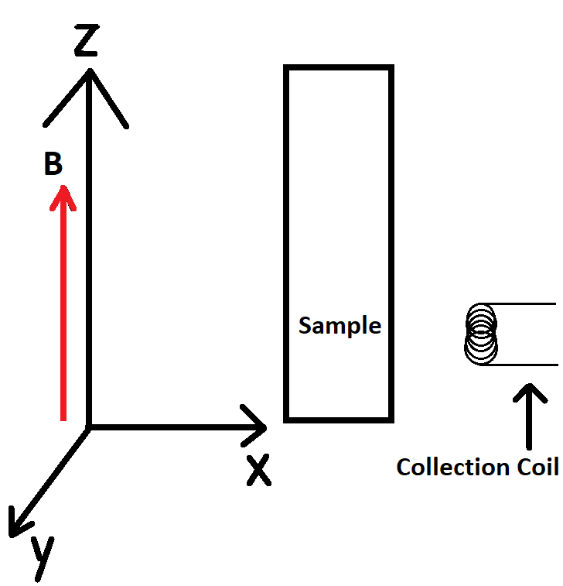
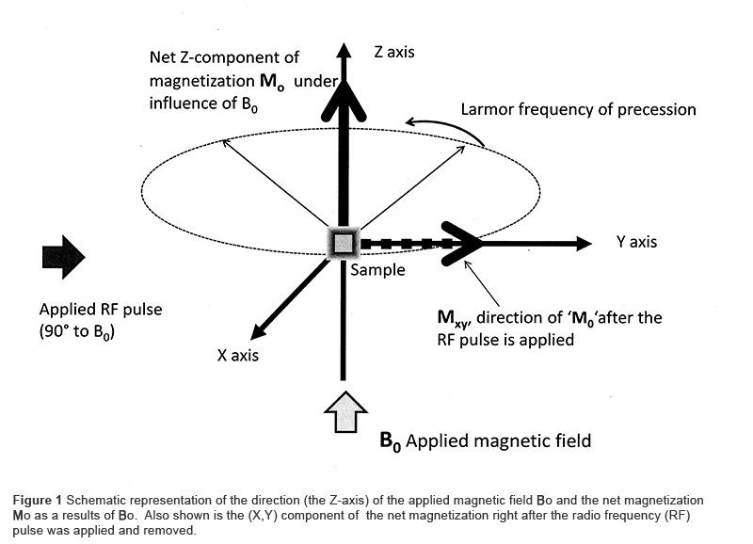
PULSED NMR SPECTROSCOPY
Depending on the instrumentation used, the orientation of the sample’s aggregate nuclear magnetization is critical to data collection.
For example, the TeachSpin PS2 is configured to read magnetic field changes in the X-Y plane only, and Z oriented magnetization is not measured (interpreted as zero voltage).
The magnetization be manipulated by briefly pulsing the resonant signal for some length of time. Ensuring planar orientation at the time of measurement maximizes the voltage reading, compared to a constant resonant signal.
TeachSpin PS2 NMR Spectroscopy set Photo by Jarod White from U of Minnesota
The pulse lengths corresponding to 90- and 180- degree magnetization rotation are of particular use, as they can be used to experimentally measure both the spin-lattice (T1) and spin-spin (T2) relaxation times of a given sample.
These relationships are modeled by the Bloch Equations (see slide 6)
A simple visual of the emitting/collecting coil orientation relative to sample and magnetic field
Source: AOCS Lipid Library

Slide 5
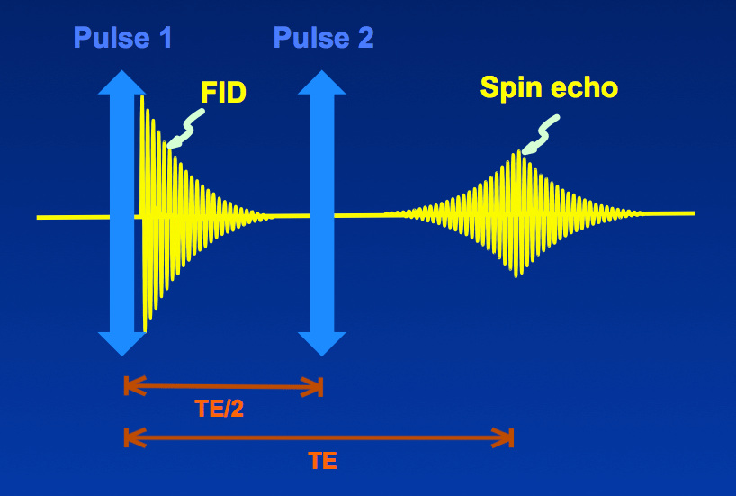
Delay Time Between Pulses
A two-pulse sequence allows us to see some relaxation occur before the second pulse.
Immediately after a 180º pulse, we primarily see longitudinal relaxation.
We read signal at 90º; we see relaxation from 180º to 90º
Immediately after a 90º pulse, we see more transverse relaxation.
Increasing delay time allows more relaxation to occur.
We can use any two angles for creating spin echoes, but the most common is 90º then 180º.
Despite this being called the “Hahn Echo,” Erwin Hahn’s original experiment in 1949 used two 90º pulses.

Slide 6
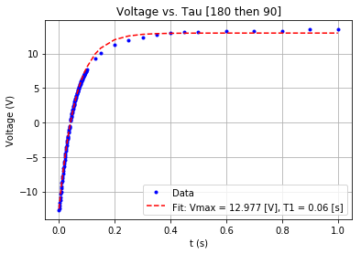
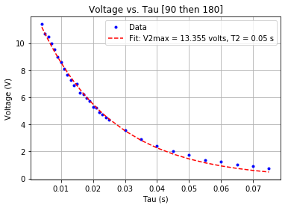

Bloch Equations
T1 [ms] | T2 [ms]
60.0 ± 0.2 | 50.0 ± 0.7
Proposed by Felix Bloch in 1946 to describe net sample nuclear magnetization as a function of time in NMR experiments.
A set of macroscopic differential equations:
$$\frac{dM_{x/y}(t)}{dt}=γ{\left(\hat{M}\left(t\right)×\hat{B}\left(t\right)\right)}_{x/y}−\frac{\hat{M_{x/y}}(t)}{T2}$$
$$\frac{dM_{z}(t)}{dt}=γ{\left(\hat{M}\left(t\right)×\hat{B}\left(t\right)\right)}_{z}−\frac{\hat{M_{z}}\left(t\right)−\hat{M_{0}}}{T1}$$
These equations, together with the assumption that net sample magnetization is directly proportional measured voltage, and the application of the external magnetic field only in the Z direction, give a model for voltage (or magnetization) as explicit functions of time, the shape of which is determined by the relaxation times T1 and T2.
Note that in the case of zero relaxation, T1 and T2 go to infinity and
$$\frac{d\hat{M}}{dt}=γ\left(\hat{M}×\hat{B}\right)$$
Which is just the Larmor frequency of precession.
These models were used to extrapolate T1 and T2 for mineral oil, as shown by the fits to the raw data collected.

Slide 7
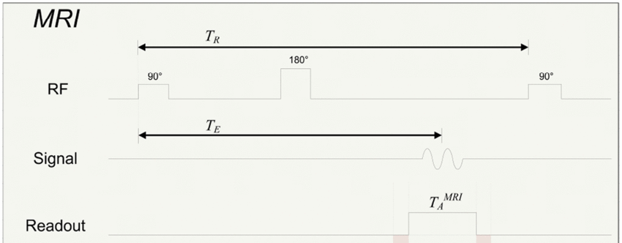
Period between Sequences
If the period between sequences isn’t at least the time it takes for all spins to relax, we have extended the sequence, not started a new one.
There are several sources which can affect T1 and T2 that we cannot guarantee are the same each time:
Exact strength of magnetic field
Homogeneity of magnetic field
Exact temperature of the substance
Probabilistic Distribution: The more spins we have, the longer it will take to guarantee that all spins relax.
We want to have lots of room for error – ten times our initial guess for the relaxation time provides this.

Slide 8
Works Cited
Gebhardt, P, et al. “Figure.” ResearchGate, ResearchGate, 2019, www.researchgate.net/figure/Simplified-time-diagram-of-a-MRI-spin-echo-sequence-acquisition-period-as-defined-by-the_fig1_270458236.
Hoffman, Roy. “NMR Relaxation.” NMR Relaxation, 26 Dec. 2018, chem.ch.huji.ac.il/nmr/techniques/other/t1t2/t1t2.html.
“Spin Echo (SE).” Questions and Answers ​in MRI, ELSTER LLC., 2018, mriquestions.com/spin-echo1.html.
“Spin-Lattice and Spin-Spin Relaxation.”
“T1 (Spin-Lattice) Relaxation.”Questions and Answers in MRI, ELSTER LLC, 2018, mriquestions.com/what-is-t1.html.
“T2 (Spin-Spin) Relaxation.” Questions and Answers in MRI, ELSTER LLC, 2018, mriquestions.com/what-is-t2.html.

